Slide 1




Astronomy 1010 chapter 13
Clayton State University
Slides for Astronomy textbook from OpenStax
https://openstax.org/books/astronomy/

Slide 2
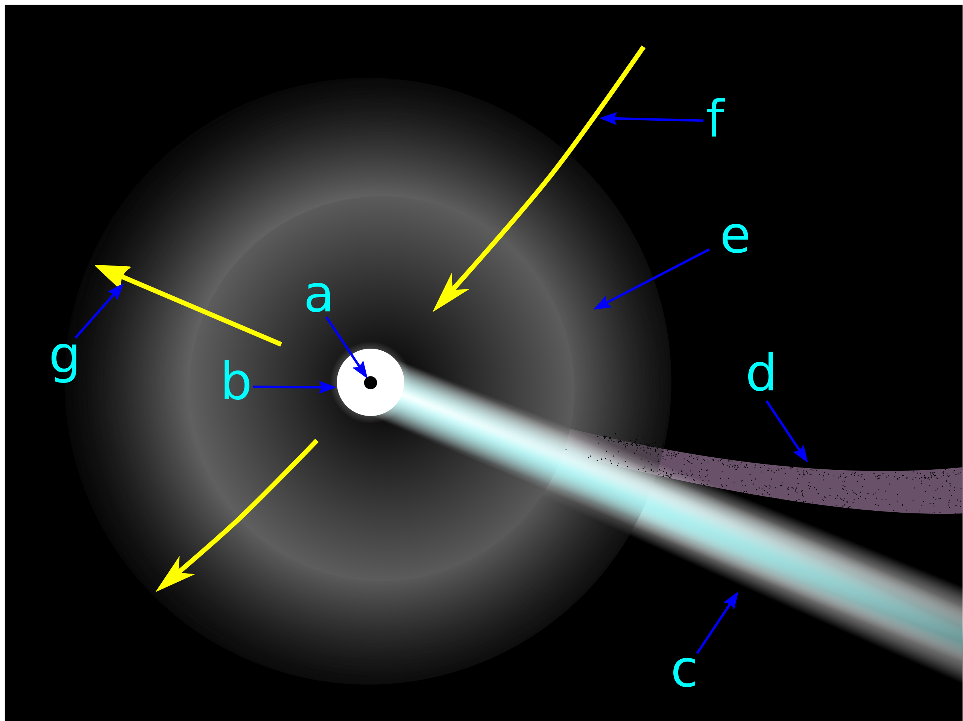
What is a comet?
From Wikipedia - The word comet derives from the Old English cometa from the Latin comēta or comētēs
It is a latinization of the Greek κομήτης - "wearing long hair".
Κομήτης was derived from κομᾶν ("to wear the hair long"), which was itself derived from κόμη ("the hair of the head") and was used to mean "the tail of a comet".
Physical characteristics of a Comet.
Nucleus
Coma
Gas/Ion tail
Dust tail
Hydrogen envelope
Movement of the Comet
Direction to the Sun.

Slide 3
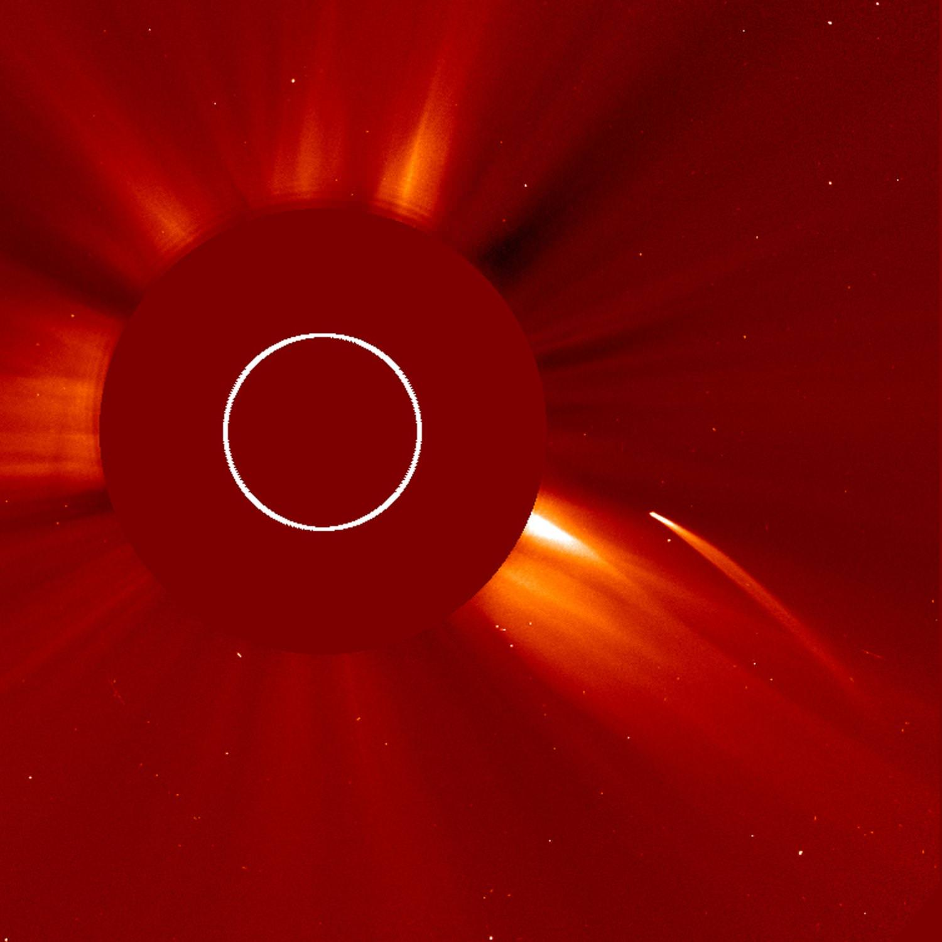
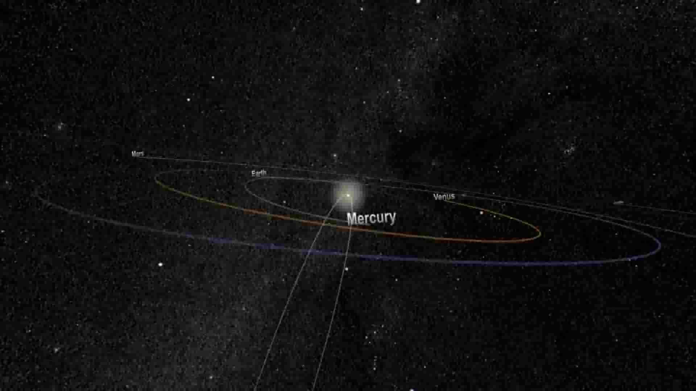
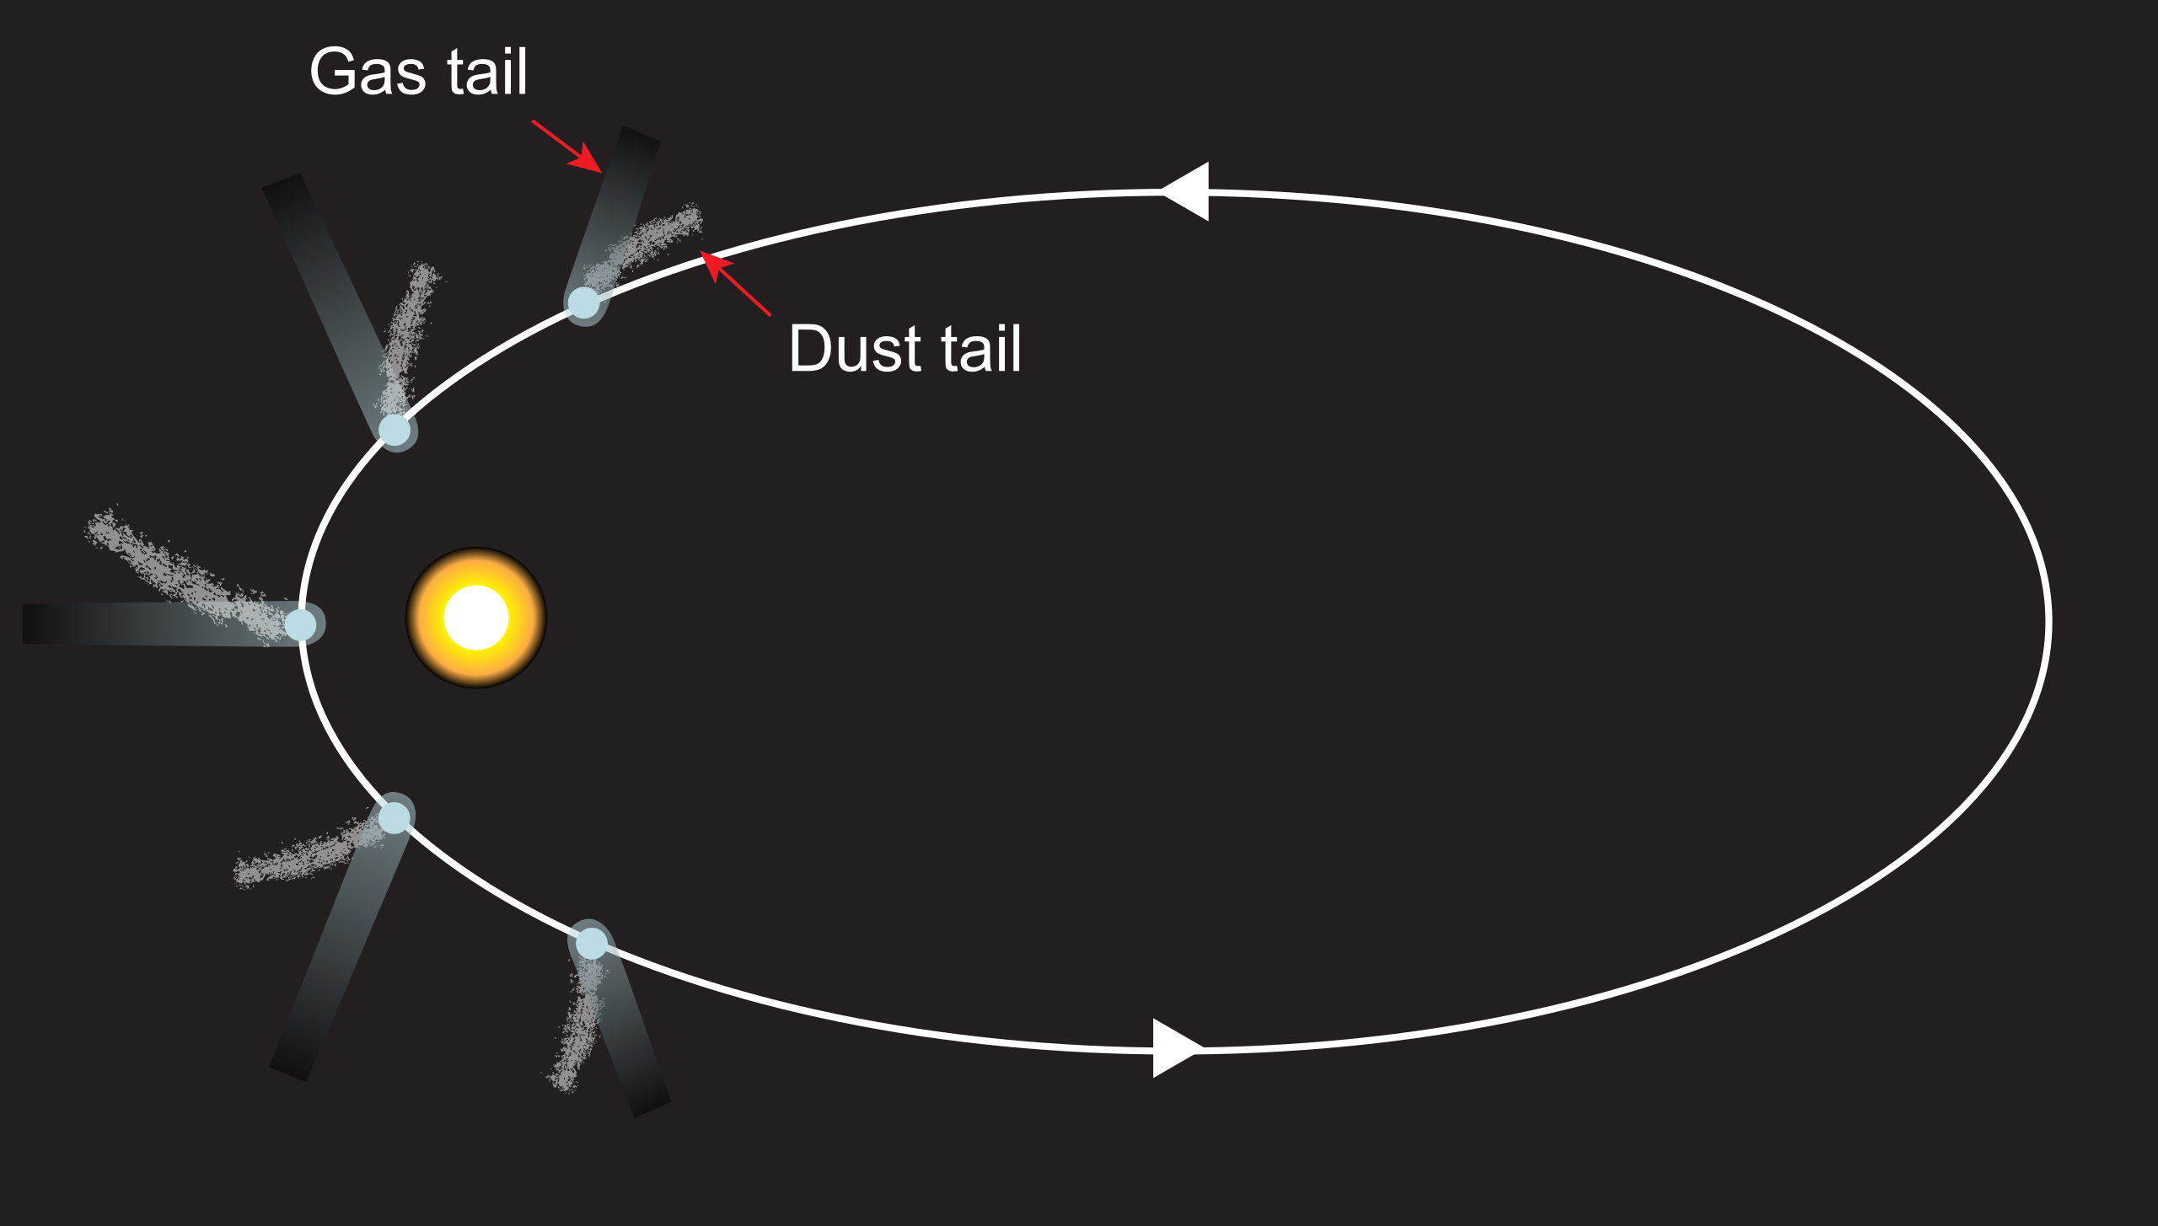
Parts of the comet
The nucleus is the solid, central part of a comet, once termed a dirty snowball or an icy dirtball.
A cometary nucleus is composed of rock, dust, and frozen gases.
When heated by the Sun, the gases sublimate and produce an atmosphere surrounding the nucleus known as the coma.
The force exerted on the coma by the Sun's radiation pressure and solar wind cause an enormous tail to form, which points away from the Sun.
Comets originate mostly from Oort cloud and have very eccentric orbits. Some come back periodically, some are destroyed, some don’t return

Slide 4
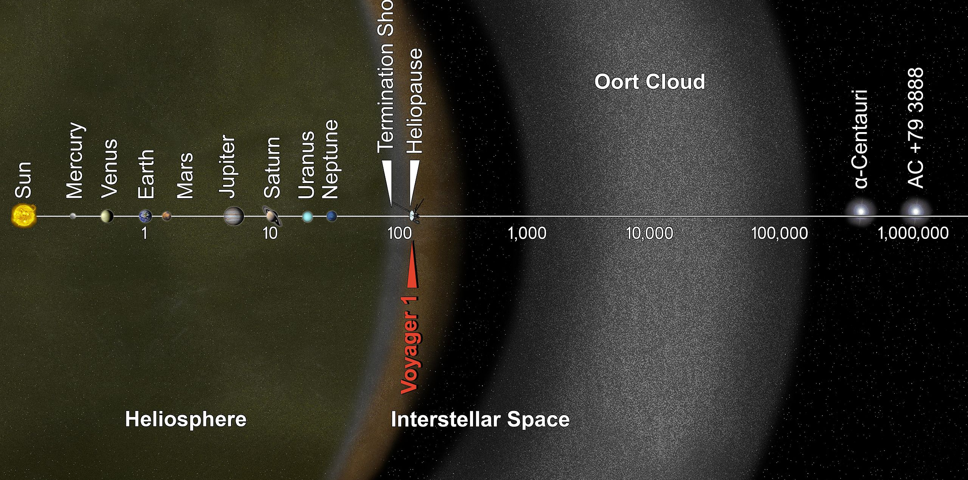
Oort Cloud
The distance from the Oort cloud to the interior of the Solar System, and two of the nearest stars, is measured in astronomical units. The scale is logarithmic; each indicated distance is ten times farther out than the previous distance. The red arrow indicates the location of the space probe Voyager 1, which will reach the Oort cloud in about 300 years.

Slide 5
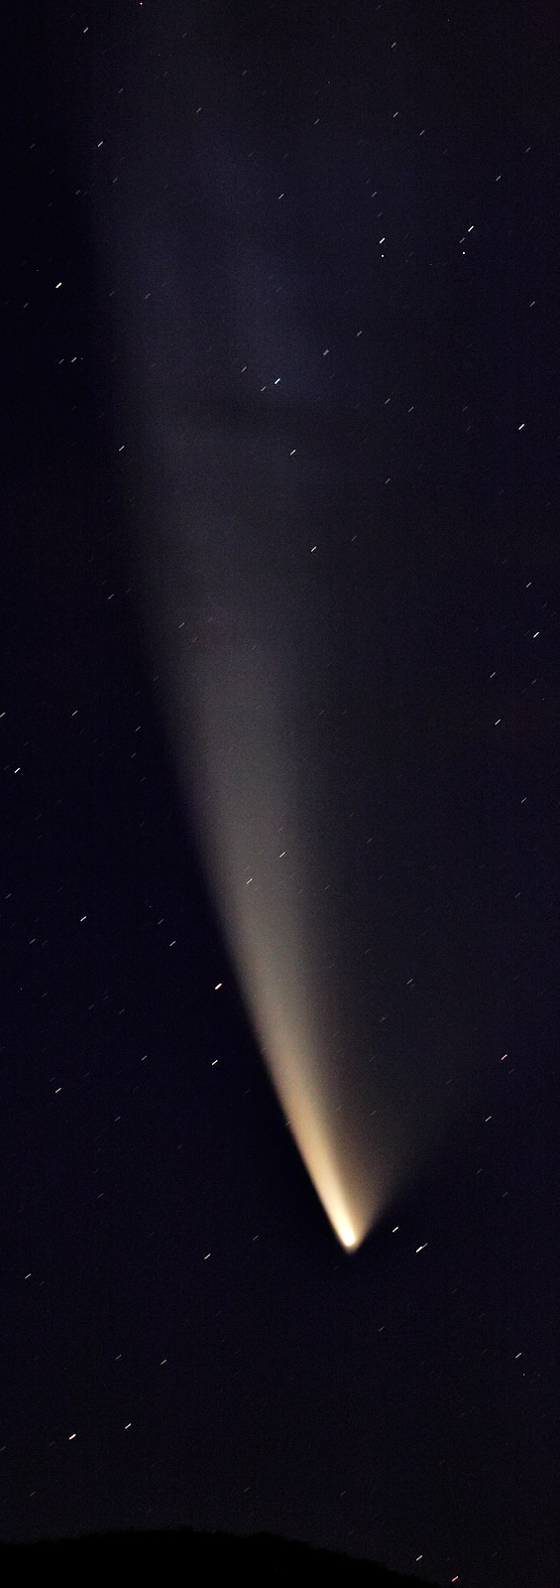
Halley Comet
Halley's Comet or Comet Halley, officially designated 1P/Halley,^{[2]} is a short-period comet visible from Earth every 75–76 years.^{[2][10][11][12]}
Halley is the only known short-period comet that is regularly visible to the naked eye from Earth, and the only naked-eye comet that can appear twice in a human lifetime.^{[13]} Halley last appeared in the inner parts of the Solar System in 1986 and will next appear in mid-2061.^{[14]}
Halley's periodic returns to the inner Solar System have been observed and recorded by astronomers around the world since at least 240 BC.
But it was not until 1705 that the English astronomer Edmond Halley understood that these appearances were reappearances of the same comet. As a result of this discovery, the comet is now named after Halley.^{[15]}
During its 1986 apparition, Halley's Comet became the first comet to be observed in detail by spacecraft, providing the first observational data on the structure of a comet nucleus and the mechanism of coma and tail formation.^{[16][17]}
These observations supported a number of longstanding hypotheses about comet construction, particularly Fred Whipple's "dirty snowball" model, which correctly predicted that Halley would be composed of a mixture of volatile ices—such as water, carbon dioxide, and ammonia—and dust.
The missions also provided data that substantially reformed and reconfigured these ideas; for instance, it is now understood that the surface of Halley is largely composed of dusty, non-volatile materials, and that only a small portion of it is icy. (Sourced from Wikipedia)

Slide 6
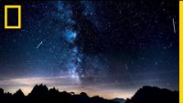
Meteor showers as comet remnants

Slide 7

Halley Comet

Slide 8

67P/Churyumov–Gerasimenko

Slide 9

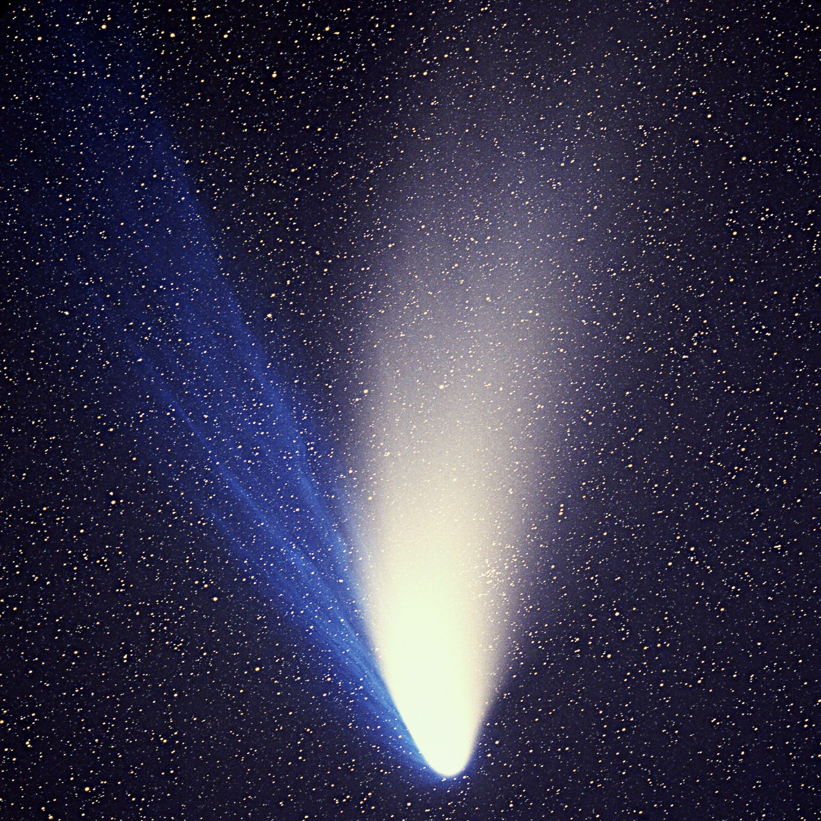
Any questions?
Could we use comets as source of water?

